Slide 1
Table of Contents
Title: Physical Properties of Water, 5.2 Temperature and Heat
Page #48
Date: 12/04/12

Slide 2
Objective
Students will be able to describe the processes by which water changes state.

Slide 3
Word of the Day
State: A condition of being in a stage or form, as of structure, growth, or development.

Slide 4
5.2 Temperature and Heat
Temperature: A measure of movement.
Molecules vibrate, the more they vibrate the higher is their temperature.
Degrees: Units of measure for temperature.
Scales:
There are 3 of them:
Fahrenheit (˚F) - Arbitrary scale
Celsius (˚C) – Based on boiling and freezing points of water
100 ˚ C and 0 ˚C
Kelvin (˚K) – Based on Absolute Zero (0 ˚K) – The temperature at which all movement stops = -273.2 ˚ C and -459.7 ˚F

Slide 5
Temperature and Heat
Heat: A measure of thermal energy.
Calories: Units of measure for heat.
1 calorie = the amount of heat needed to raise temp of 1 gram of water by 1 degree Celsius.
Example: How much heat is needed to raise 1 gram of water from 5 ˚ to 6 ˚.

Slide 6
5.3 Changes in State
Water exists on Earth as a liquid a solid and a gas.
Pure Water: Water that does not contain suspended particles, or dissolved substances, including gasses.

Slide 7
5.3 Changes of State
Adding heat to water causes molecules to move faster.
Ice is water as a solid. Water molecules in ice vibrate in place (little movement.)
Liquid. Water molecules flow past each other (constant movement.) Hydrogen bonds form, last for 1 trillionth of a second, then break, then form again.
Gas. Water molecules move out in 1 direction until they bump into each other or into the wall of the container that they are being held in.

Slide 8
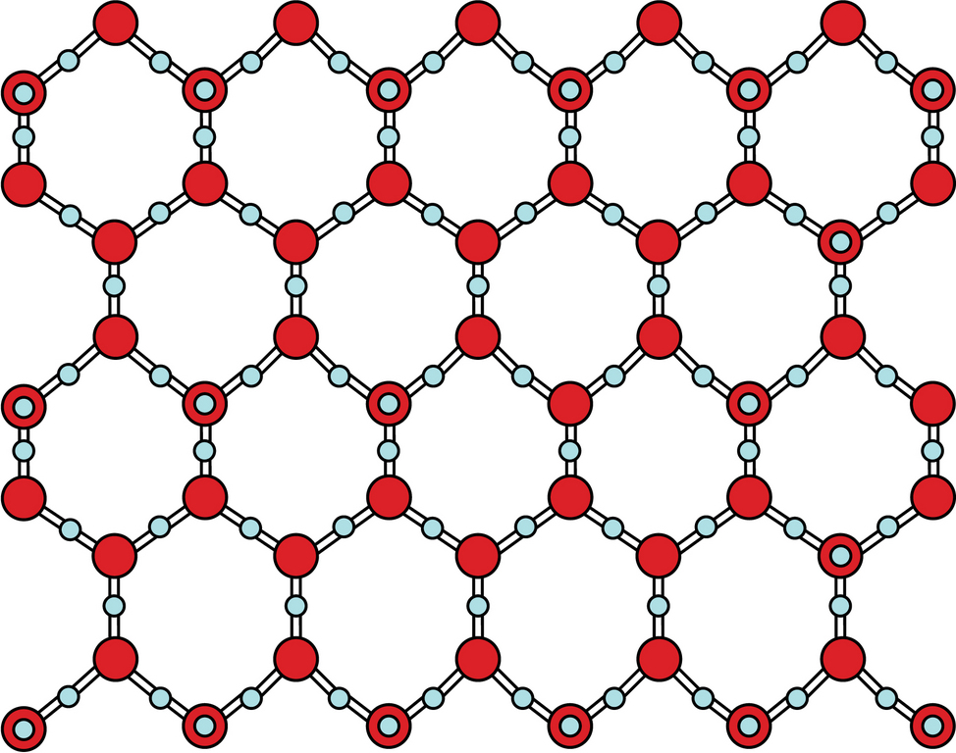
Water as a solid: Lattice network of molecules

Slide 9
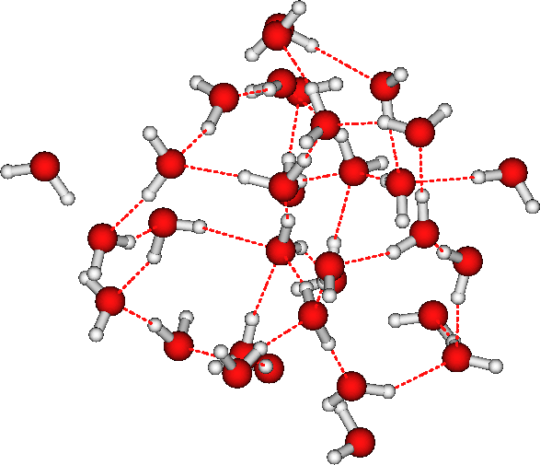
Water as a liquid. Molecules form hydrogen bonds that break and then form new hydrogen bonds.

Slide 10
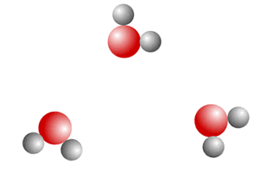
Water molecules in a gas state.

Slide 11
5.3 Changes of State
Polarity: Because water molecules are charged like magnets, they want to stay close to each other.
Dissolved Salts: Causes boiling temp of water to rise and freezing temp of water to fall.
Seawater generally does not boil naturally.
Sea ice forms at – 2 ˚C.

