Slide 1
Table of Contents
Title: Plate Tectonics, Hot Spots
Page #: 33
Date: 11/28/2012

Slide 2
Objective
Students will be able to identify hot spots on the Earth’s surface.
Students will be able to use the presence of hot spots on Earth’s surface to calculate the speed at which tectonic plates move.

Slide 3
Words of the Day
Plume: A form that is like a long feather. An upwelling of molten material from the earth’s mantle.
Erosion: The transportation of sediments by wind, moving water, glaciers or gravity.

Slide 4
Hot Spots
Hot Spot: Areas of isolated volcanic activity. 40 of them on Earth.
Hot spots channel magma to the surface of Earth from the mantle.
Hot spots will either break through lithosophere to form a volcanic peak or seamount, or may produce a broad swell that subsides as plats moves over and away from magma source.

Slide 5
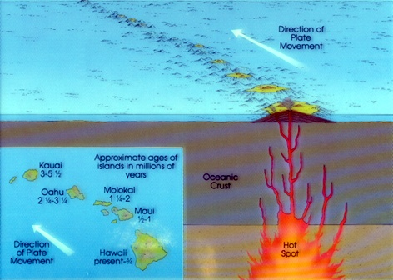
Hot Spots
Hot spots may also bring magma to the asthenosphere.
Hot spots last for about 200,000,000 years and they do not move.

Slide 6
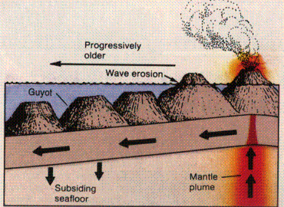
Hot Spots
As oceanic lithosphere moves over a hot spot, successive eruptions may produce a linear system of peaks, or seamounts on the seafloor.
Youngest peak is above the hot plume.
Age of peak / seamount increases as distance increases from hot plume.

Slide 7
Hot Spots
Example: Hawaiian Islands
The large island Hawaii is currently over the hot plume. It has volcanic activity – it is the youngest island.
To the west of Hawaii are older islands: Maui, Oahu, and Kauai.
These islands increase in age (get older) as you get farther from the hot spot.

Slide 8
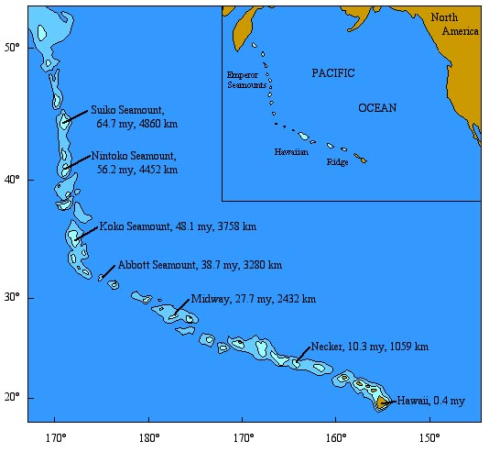
Hot Spots
Example: Emperor Seamount Chain.
The Emperor Seamounts are underwater mountains that were created by the same hotspot that made Hawaii.
These seamounts used to be above the ocean surface, but have since eroded and subsided below.

