Slide 1
Table of Contents
Title: 7.1 Heat Budget and Annual Cycles of Solar Radiation
Page #: 58
Date: 1/25/2013

Slide 2
Objective
Students will be able to explain the factors that determine the Earth’s heat budget.
Students will be able to describe the effects of the Earth’s “heat engine.”

Slide 3
Word of the Day
Latitude: The angular distance north or south of the Earth’s equator measured in degrees.

Slide 4
Heat Budget
Heat Budget: The energy Earth receives from sunlight is balanced by an equal amount of energy reradiating into space. (The total amount of radiation striking Earth is equal to the amount of radiation being reflected into space.)
If more radiation was absorbed the Earth would get hotter. If more radiation was reflected back into space the Earth would get cooler.
Because of the angle at which the Sun’s rays hit the Earth equatorial regions gain more sunlight than do polar regions.

Slide 5
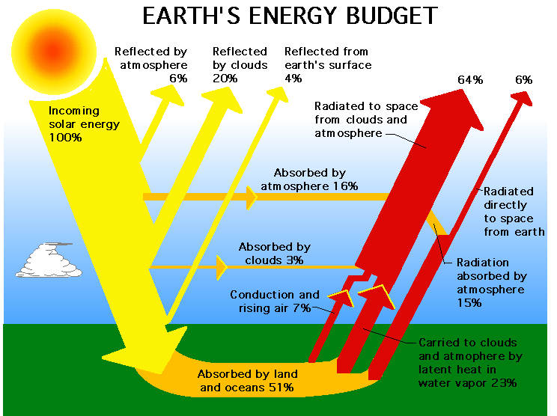

Slide 6
Heat Budget
Earth’s surface, including oceans, is heated from above by radiation.
Earth’s atmosphere is heated from below by the Earth’s surface. This creates convection currents in the Earth’s atmosphere.
Circulation in the atmosphere and in the ocean is called the Earth’s Heat Engine.

Slide 7
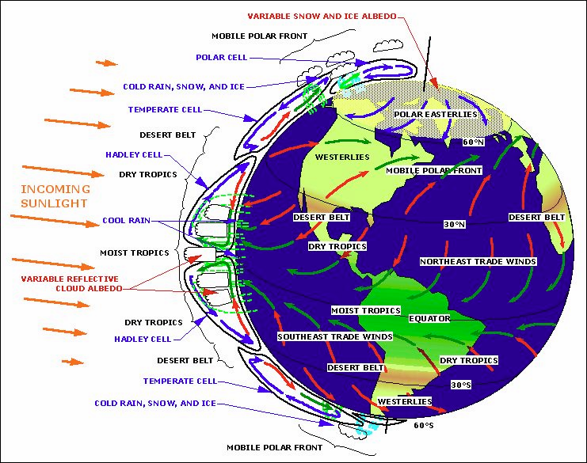
Heat Budget
Earth’s Heat Engine: Redistributes heat from the equator to the polar regions.

Slide 8
Annual Cycles of Solar Radiation
Higher latitudes have greater variation in seasonal solar radiation (more change in the amount of sunlight received from Summer to Winter.)
Annual cycles of solar radiation produce seasonal changes in land and sea surface temperatures because of heat losses or gains.
At the Equator, the Sun’s rays hit the Earth at nearly 90 degrees. As a result the intensity of solar radiation at the equator is constant.

Slide 9
