Slide 1
Table of Contents
Title: 7.2 Structure of the Atmosphere
Page #: 62
Date: 1/29/2013

Slide 2
Objective
Students will be able to describe the structure of the atmosphere.

Slide 3
Word of the Atmosphere
Atmosphere: The gaseous mass or envelope surrounding a celestial body, especially the one surrounding the earth, and retained by the celestial body's gravitational field.

Slide 4
7.2 The Atmosphere
Structure of the Atmosphere: The atmosphere is a mixture of gasses that extends 90 km (50 miles) above Earth’s surface.
99% of gasses in the atmosphere are in the first 30 km (18 miles) above Earth’s surface.
90% of gasses are in the first 15 km (9 miles) of Earth’s surface.

Slide 5
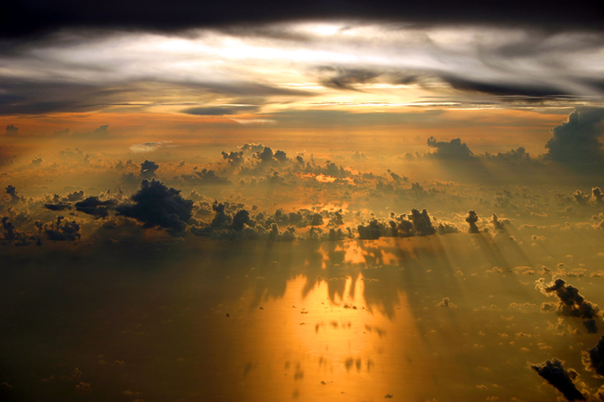
Weather occurs in the Troposhere

Slide 6
7.2 The Atmosphere
4 Layers of the Atmosphere:
Troposphere: Bottom layer of atmosphere.
Where heat moves between Earth’s surface and the atmosphere. Convection currents create winds, waves and ocean surface currents.
Extends 12 km (7 miles) off of Earth’s surface.
Temperature decreases with altitude from 16°C at surface to - 60° C at Tropopause 12 km up.

Slide 7
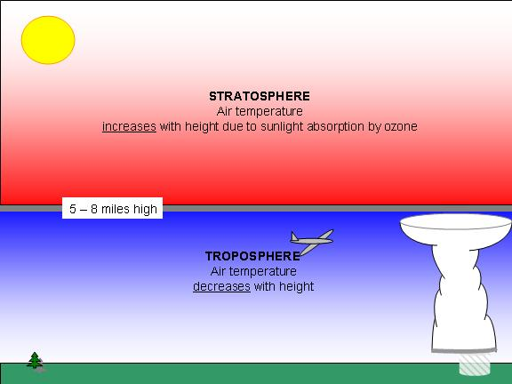
Tropopause

Slide 8
7.2 The Atmosphere
Tropopause: The point where the Troposphere ends. Temperature begins to increase with altitude.
Tropopause separates the Troposphere from the Stratosphere.

Slide 9
7.2 The Atmosphere
Stratosphere: The second layer of Earth’s atmosphere. Begins at 12 km and continues to 50 km (at the stratopause.)
Temperature increases as elevation increases.
Contains Ozone (O ) which absorbs ultraviolet radiation which causes temperature of stratosphere to rise.
Protects Earth’s surface from harmful radiation.
3

Slide 10
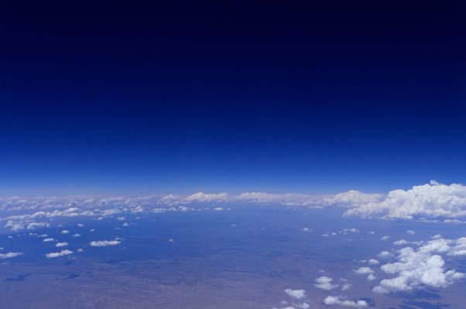
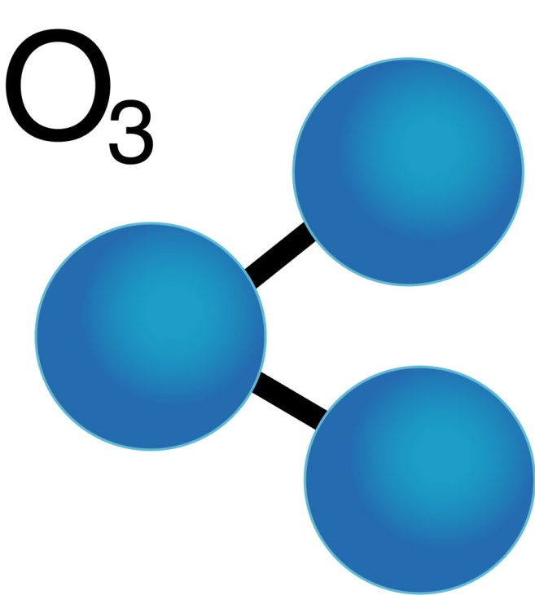
The Stratosphere
Contains ozone
Which absorbs
ultraviolet radiation.

Slide 11
7.2 The Atmosphere
Mesosphere: 50 km to 90 km (at Mesopause.)
Temperature decreases with altitude. Air pressure is only 1/1000 of air pressure at Earth’s surface.
Thermosphere: Extends from 90km to space.

Slide 12
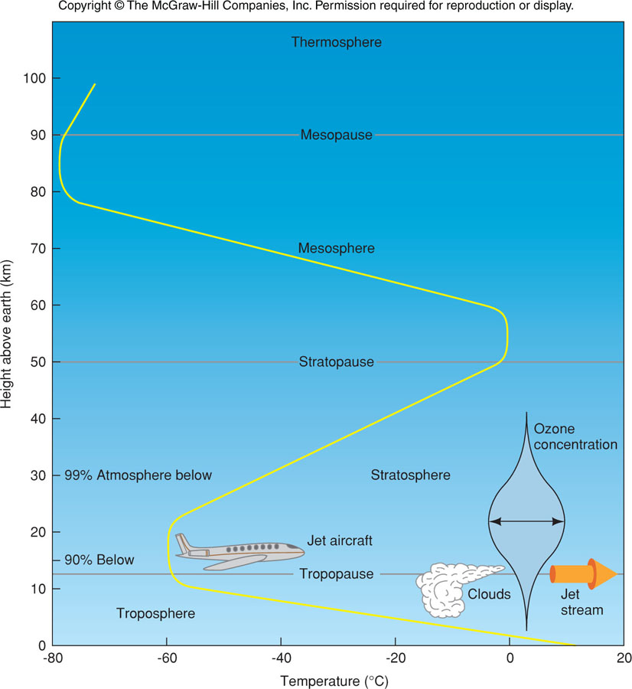
Earth’s Atmosphere

Slide 13
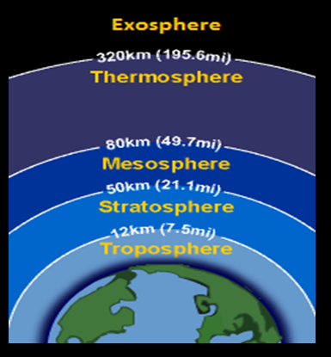

Slide 14
