Slide 1
Table of Contents
Title: 7.1 Specific Heat and Heat Capacity
Page #: 62
Date: 1/29/2013

Slide 2
Objective
Students will be able to compare and contrast the specific heat and heat capacities of oceans and land.

Slide 3
Word of the Day
Heat Capacity: The amount of heat energy required to raise the temperature of a substance by one unit.

Slide 4
Specific Heat and Heat Capacity
Land: Has a low heat capacity – Its temperature will change a lot as it undergoes changes in heat.
Ocean: Has a large heat capacity – Its temperature will not change very much as it absorbs and releases heat.

Slide 5
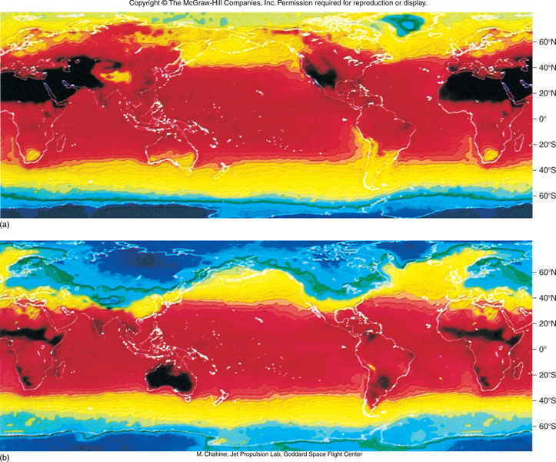
Heat distribution
In July
Heat distribution
In January

Slide 6
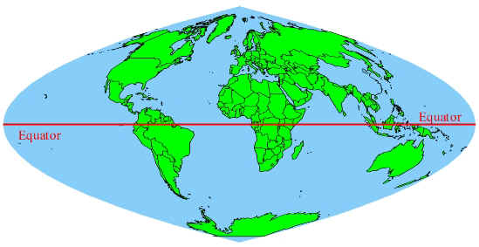
Specific Heat and Heat Capacity
2/3 of Earth’s landmass is located in the Northern Hemisphere.
Means Northern Hemisphere experiences greater temperature variation during the year than does Southern Hemisphere.

